Slide 1
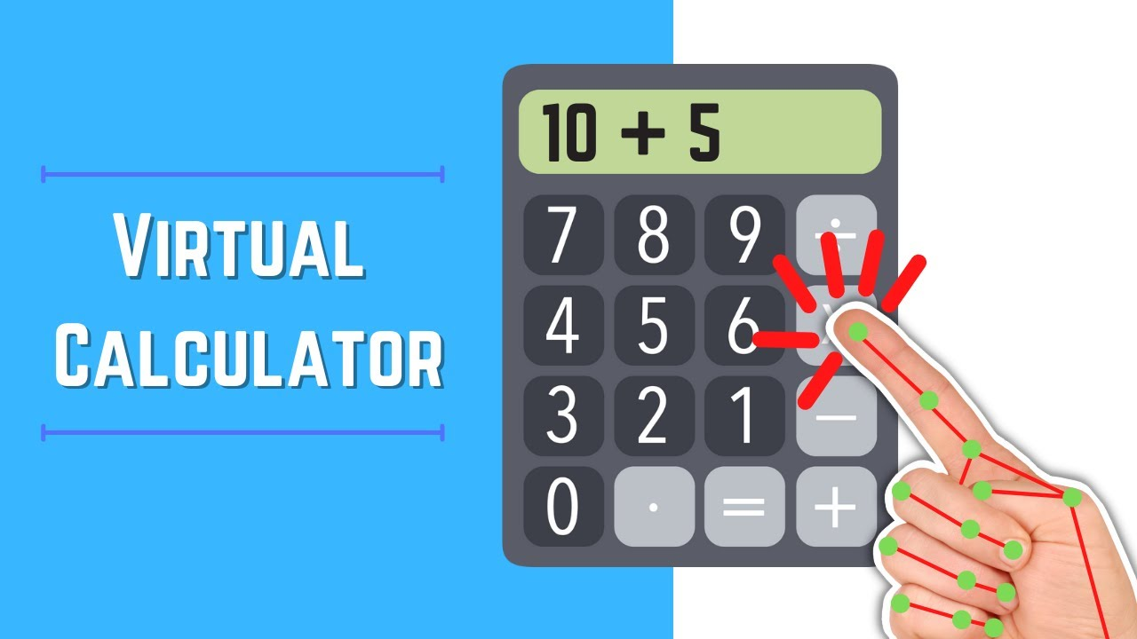
Virtual Hand-Gesture Based Calculator Using OpenCV and cvzone
Presented By:-
RANJANA SAHA 2105053
ARNAB DAS 2105183
NIRMALLYA DUTTA 2105212
SOUMYADEEP SAHA 2105246
SANGBARTIKA SAHA 21051334

Slide 2
Virtual Hand-Gesture Based Calculator Using OpenCV and cvzone
Welcome to our innovative project: a Virtual Hand-Gesture Based Calculator powered by OpenCV and cvzone. This cutting-edge application leverages computer vision technology to create an intuitive, touchless interface for performing mathematical calculations. By combining the power of OpenCV for image processing and cvzone for hand tracking, we've developed a system that translates hand gestures into calculator inputs, revolutionizing the way we interact with digital tools.
Our team has worked tirelessly to create a seamless user experience that bridges the gap between physical and digital interactions. This presentation will guide you through the intricacies of our project, from its conceptual foundations to its practical applications and future potential.

Slide 3
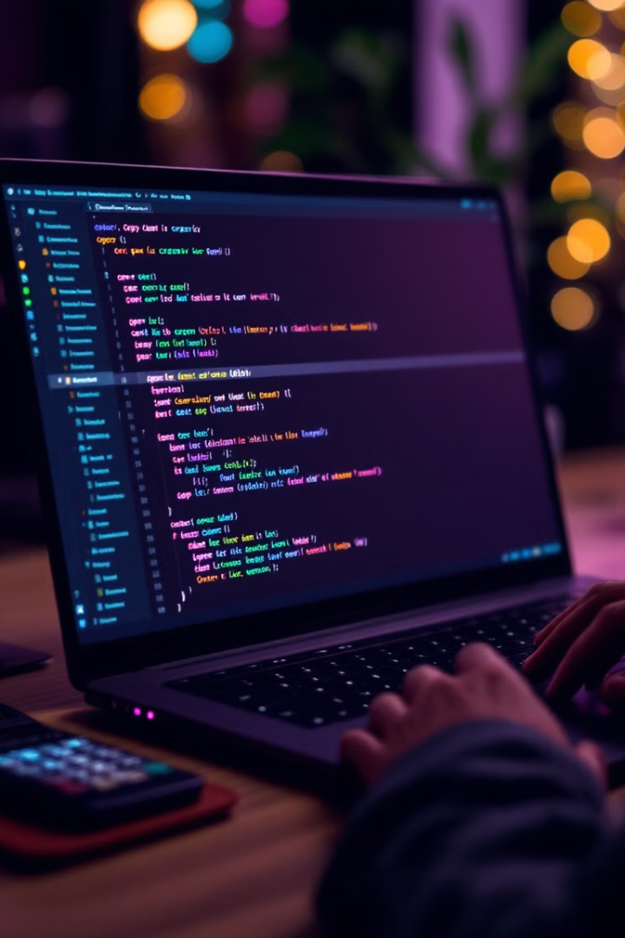
Tech Stack: OpenCV, cvzone, and Python
Our project utilizes a robust technology stack, combining the power of OpenCV, cvzone, and Python to achieve our goal of creating a virtual hand-gesture based calculator.

Slide 4
Project Overview and Significance
Problem Statement
Significance
Innovation
Traditional calculators and gesture-based interfaces can be limiting for users with mobility issues or in environments where physical contact is undesirable. Our project addresses this by creating a contactless, intuitive calculator interface using hand gestures.
This project demonstrates the potential of computer vision in creating accessible, hygienic, and engaging user interfaces. It opens up new possibilities for human-computer interaction, particularly in educational and professional settings.
By combining OpenCV's robust image processing capabilities with cvzone's specialized hand tracking, we've created a system that accurately interprets hand gestures in real-time, translating them into calculator functions.

Slide 5




Tech Stack: OpenCV, cvzone, and Python
OpenCV
Python
cvzone
OpenCV (Open Source Computer Vision Library) provides the core image processing and computer vision algorithms. It enables real-time image capture, processing, and analysis, forming the backbone of our gesture recognition system.
Python serves as the primary programming language for our project. Its rich ecosystem of libraries and ease of use make it ideal for rapid prototyping and development of computer vision applications.
cvzone, a computer vision package built on top of OpenCV, provides advanced hand tracking capabilities. It simplifies the process of detecting and tracking hand landmarks, enabling precise gesture recognition.

Slide 6




System Architecture: Gesture Capture and Processing
Image Capture
Hand Detection
Gesture Recognition
Calculation and Display
The system begins by capturing real-time video input from the device's camera using OpenCV. This continuous stream of images serves as the raw data for gesture recognition.
cvzone's hand tracking module analyzes each frame to detect and isolate hand regions. It identifies key landmarks on the hand, such as fingertips and joints, crucial for gesture interpretation.
The system interprets the relative positions and movements of hand landmarks to recognize specific gestures. These gestures are mapped to calculator functions and numeric inputs.
Recognized gestures trigger corresponding calculator operations. Results are computed in real-time and displayed on the virtual interface, providing immediate feedback to the user.

Slide 7
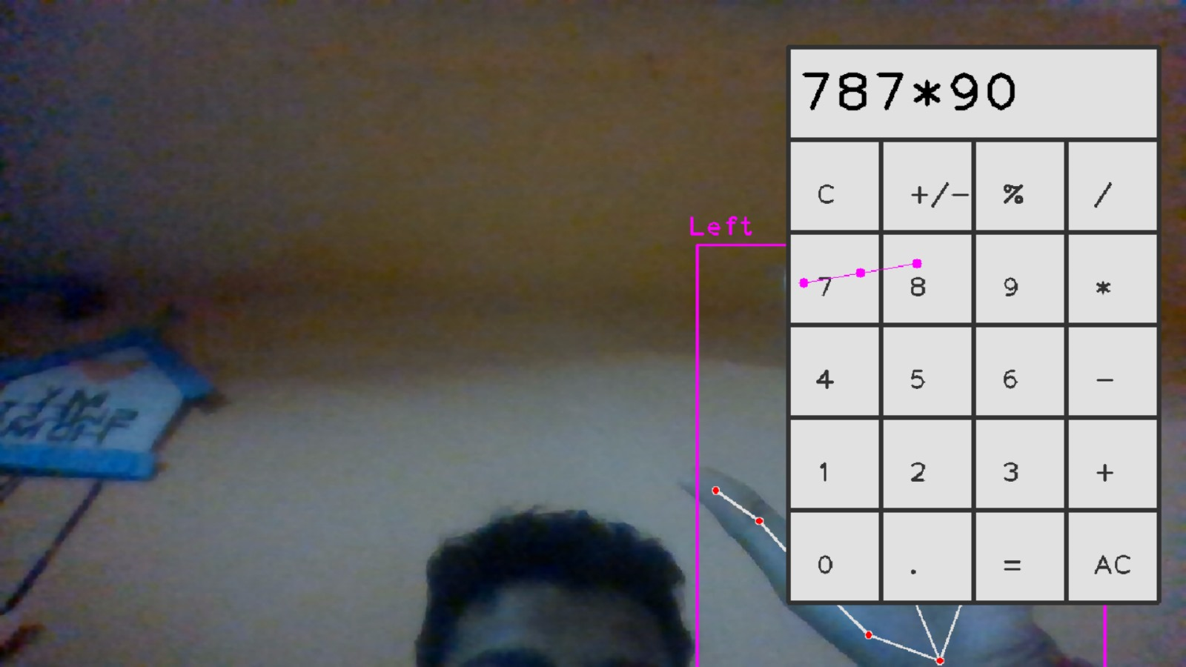
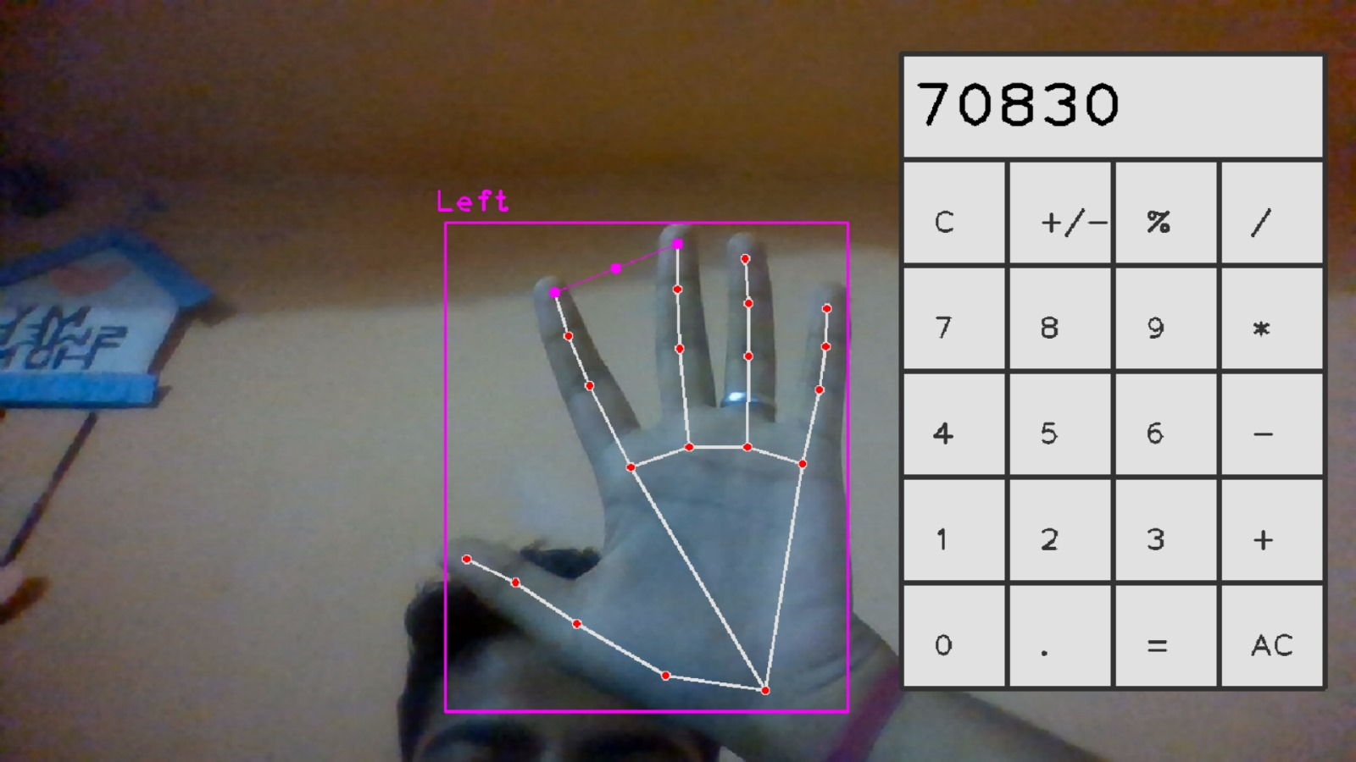
Gesture Recognition and Virtual Button Manipulation
1
Finger Tracking
2
Virtual Button Mapping
Our system utilizes cvzone's hand tracking to precisely locate and track individual fingers. This allows for detailed gesture interpretation, distinguishing between different finger positions and movements.
We create a virtual grid of calculator buttons in the camera's field of view. Each button is associated with a specific region in space, allowing users to "press" buttons by moving their fingers to these predefined areas.
3
Gesture-Function Mapping
Specific hand gestures are mapped to calculator functions. For example, a pinch gesture might represent the equals sign, while extending all fingers could clear the display. This intuitive mapping enhances user experience and ease of use.

Slide 8
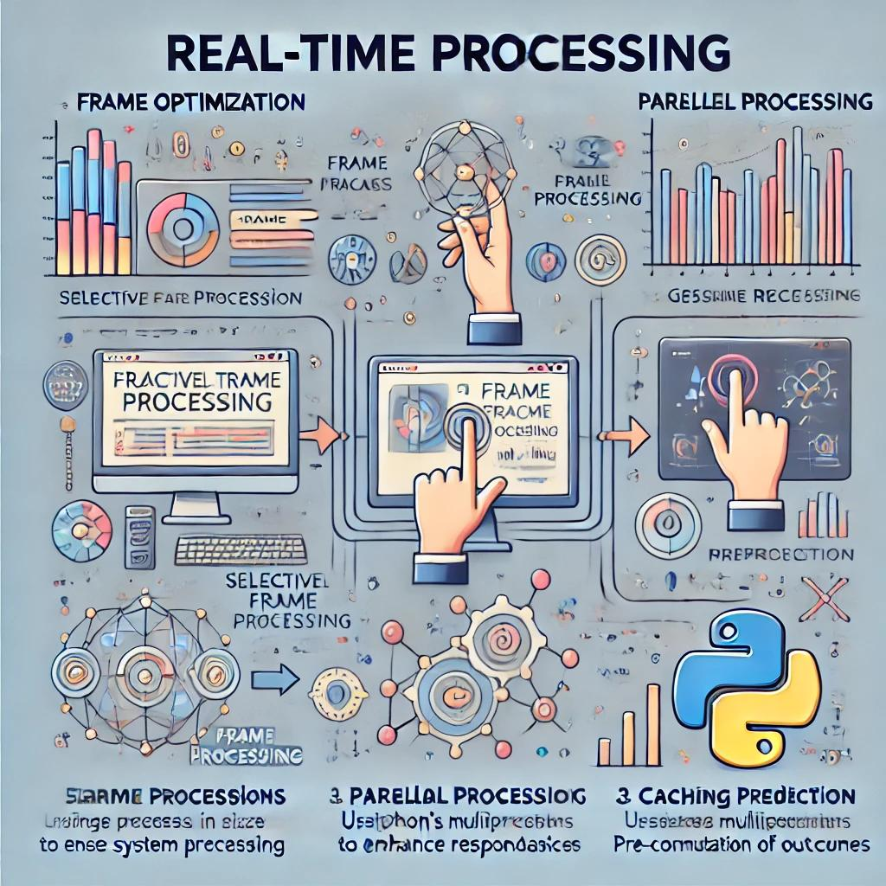
Real-time Processing: Efficient Computational Techniques
1
Frame Optimization
To ensure smooth real-time performance, we implement frame rate optimization techniques. This includes selective frame processing and resolution adjustment based on system capabilities and processing requirements.
2
Parallel Processing
We leverage Python's multiprocessing capabilities to parallelize computationally intensive tasks. This allows for simultaneous hand detection, gesture recognition, and interface updates, significantly improving overall system responsiveness.
3
Caching and Prediction
Implementing intelligent caching mechanisms and predictive algorithms helps reduce redundant computations. By anticipating likely user actions based on previous gestures, we can pre-compute potential outcomes, further enhancing real-time performance.

Slide 9
Applications: Education and Accessibility Use Cases
Educational Enhancement
Accessibility Solutions
Hygiene in Shared Environments
In educational settings, our virtual calculator can make mathematics more engaging and interactive. Students can visualize calculations in a fun, hands-on manner, potentially improving understanding and retention of mathematical concepts.
For individuals with mobility impairments or conditions that make using traditional calculators challenging, our gesture-based system offers a more accessible alternative. It enables users to perform calculations with minimal physical effort.
In settings where multiple users share calculators, such as libraries or exam halls, our touchless interface provides a hygienic solution, reducing the risk of germ transmission through shared surfaces.

Slide 10
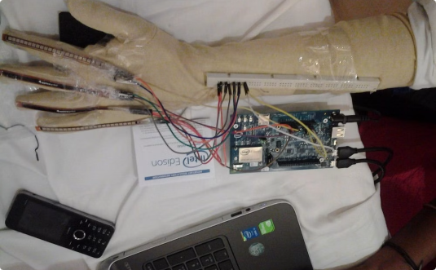
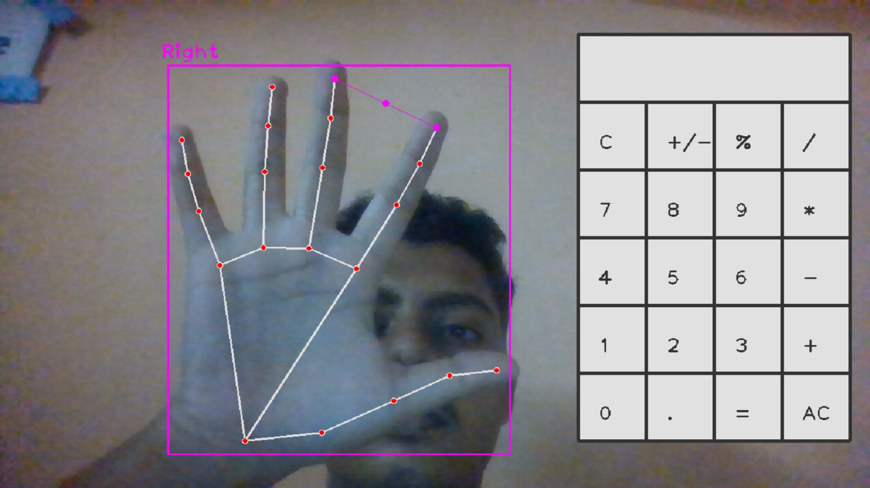
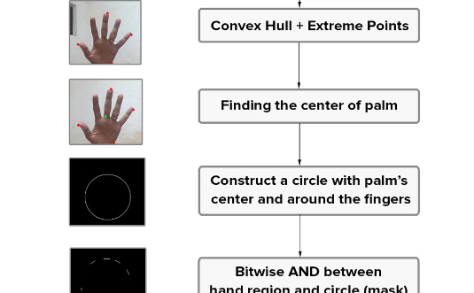
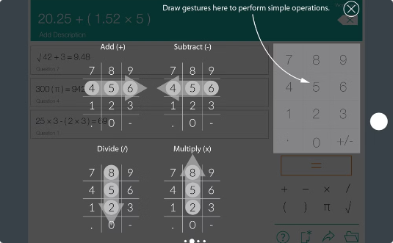
Project Demo: Video and Screenshots
User Interface
Gesture Recognition
Complex Calculations
Our virtual calculator interface features a clean, intuitive design. Large, easy-to-read buttons and a clear display ensure users can easily visualize their calculations and inputs.
This screenshot demonstrates the system's ability to accurately recognize and interpret various hand gestures, translating them into calculator inputs in real-time.
Our system is capable of handling complex mathematical operations, as shown in this image of a user performing a multi-step calculation using only hand gestures.

Slide 11
Challenges and Limitations
Lighting Sensitivity
Occlusion Issues
The system's performance can be affected by varying lighting conditions. Inconsistent or poor lighting may lead to reduced accuracy in hand detection and gesture recognition, potentially causing input errors.
When parts of the hand are obscured or overlap, the system may struggle to accurately interpret gestures. This can occur due to hand positioning or the presence of objects in the camera's field of view.
Scalability Concerns
User Adaptation
As the complexity of calculations increases, the system may face challenges in maintaining real-time performance. Balancing gesture complexity with computational efficiency remains an ongoing challenge.
Users unfamiliar with gesture-based interfaces may require time to adapt. Ensuring intuitive gesture design and providing adequate user training are crucial for widespread adoption.

Slide 12
Future Scope: Expanding Possibilities
Multimodal Input
AI-Enhanced Accuracy
Integrating voice commands alongside hand gestures could enhance usability and accessibility. This multimodal approach would allow users to choose their preferred input method or combine methods for more complex operations.
Implementing machine learning algorithms to improve gesture recognition accuracy over time. The system could learn from user interactions, adapting to individual gesture styles and improving overall performance.
1
2
3
4
Advanced Gesture Library
Cross-Platform Integration
Expanding the gesture recognition capabilities to include a wider range of hand movements and configurations. This could enable more complex mathematical functions and support for scientific or graphing calculator features.
Developing the system as a cross-platform solution, enabling its use on various devices including smartphones, tablets, and smart TVs. This would increase accessibility and broaden the potential user base.

Slide 13
Conclusion: Summary of Benefits
A novel, accessible, and engaging method for performing calculations
Enhanced accessibility for individuals with disabilities
Provides a hands-on learning experience for students
Potential for integration with other devices and platforms

Slide 14
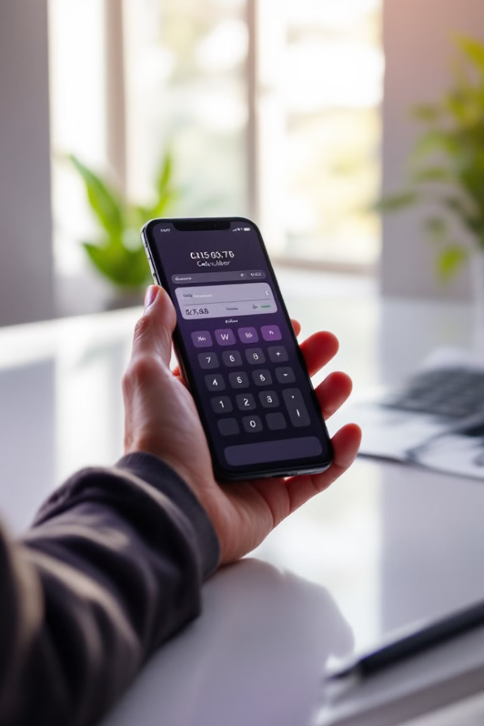
Thank You
We appreciate your time and interest in our virtual hand-gesture calculator project.
Presented By:-
RANJANA SAHA 2105053
ARNAB DAS 2105183
NIRMALLYA DUTTA 2105212
SOUMYADEEP SAHA 2105246
SANGBARTIKA SAHA 21051334

